Slide 1
A Real Time Application to Identify Alcoholics from ECG Signals
Akarsh N Kolekar (1PI13EC009) Guide: Dr. b Niranjana Krupa
Apoorv Vatsal (1PI13EC017)
Rakshith Vishwanatha (1PI13EC075)

Slide 2
STATUS QUO – Breathalyser Disadvantages
Contamination -- SiO2 sensor -- frequent recalibration
Breathalyzers medium for contagious diseases
Interfering components (like acetone) -- detected falsely
Infrared sensors are prone to error in environments – lighting, windy, polluted
To develop a prototype to read ECG signals, perform HRV analysis to extract features, and use these to classify the person under test as an alcoholic (person under the influence of alcohol) or otherwise.

Slide 3
SOLUTION
Implement a method that is less prone to environmental disturbances and corrosion
Electrode contacts are less prone to corrosion and contamination than breathalyser sensor
Implement a method that requires no recalibration
Well trained machine learning algorithms will output consistent results over time and will not require recalibration once calibrated
Less scope for disease propagation
Contact through hand and not mouth

Slide 4
OVERALL FLOW
Training ECG data available (NIMHANS) – 30 samples
MATLAB used to train and obtain weights
Weights of trained system updated to Raspberry Pi
Real Time ECG data collected using ECG sensor
Pattern classifier present on Raspberry Pi used to classify data

Slide 5
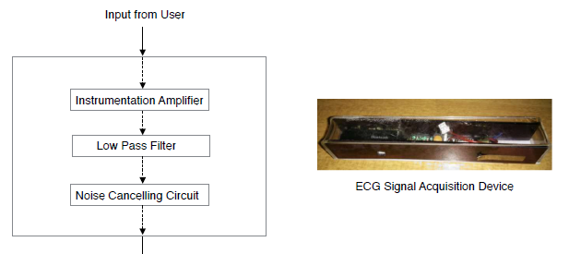
BLOCK REPRESENTATION

Slide 6
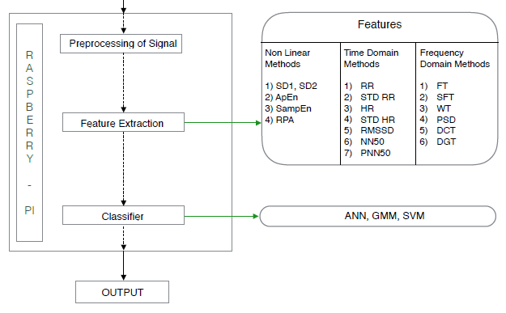
BLOCK REPRESENTATION

Slide 7
SOFTWARE & HARDWARE
SOFTWARE:
MATLAB – to train system and obtain weights
Python Libraries – implementation of PC on Raspberry Pi
Multisim – Sensor modifications and tuning
HARDWARE:
Raspberry Pi – processing board to implement the classifier
ECG Sensor – to read real time ECG signal

Slide 8
EXPECTED OUPUT
End to end working model of the system
Real time ECG graphs will be obtained, features from the graph will be extracted, and classification of test subject as alcoholic or normative will be performed

